Slide 1

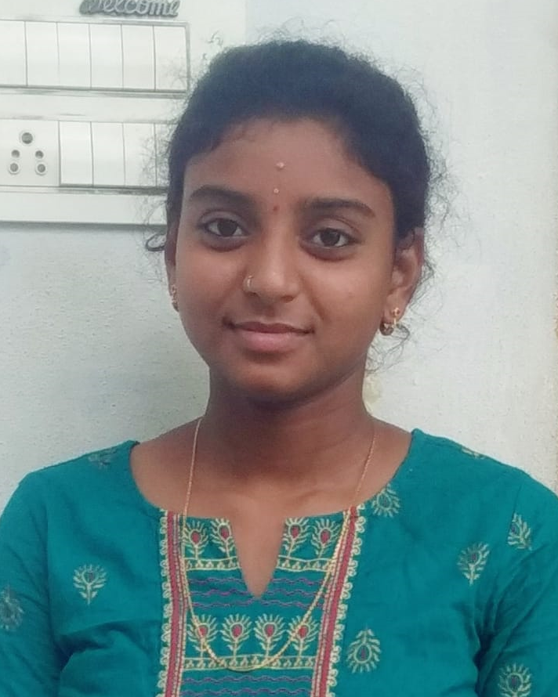
Pushpa Muddana
Analyst/Software Engineer
Education and certificates
Bachelor of Technology
Electrical and Electronics Engineering :2017 - 2021
Skills
Java 8 / J2EE
Spring Boot Spring MVC JPA CRUD
Bootstrap
Base Location: Mumbai
Email ID: muddana-pushpa-venkata-ramya.vani@capgemini.com
Mobile No: +91 9573535178
Grade: A4
Backend Spring Boot , Spring Core, Spring
MVC, Spring Security.
Hibernate REST-API
Strengths
Achivement
Full Stack Developer trained on Java Hands on experience on Git & GitHub
MongoDB & PostgreSQL
Core Java
JPA with Hibernate
Spring Frame Work
HTML 5, CSS 3, Boot Strap, JavaScript
React
Name Board Gift
Database
MongoDB SQL database – MySQL,
Postgres SQL
Completed end to end case study of Name Board Gift along with Postman Authentication. Material - UI and React Bootstrap used for user interface.
Expense Tracker
It is a software or application that helps to keep an accurate record of your money nflow and outflow.
User can enter their Daily expenses and all the expenses entered for the day will be saved and calculated .
Web Technologies
HTML5
CSS3
JavaScript Bootstrap
Add On Maven Postman Swagger
Eager to work in a team of dedicated people and serve a key role in the enhancement and development of the project.
Agriculture Crop System Created a Agriculture Crop System application using Microservices with Spring Boot And MongoDb Atlas as a Database along with Postman and Thuder Client ,JWT .React as frontend , used HTML 5,CSS,JavaScript and for designing responsive web page
Additional Details
Good Communication Skills
Team management
Software Engineer who is Strong in design and integration with intuitive problem-solving skills. Passionate about implementing and launching new projects.
Presentation Title | Author | Date © Capgemini 2017. All rights reserved | 1

